Slide 1


Introduction to Medicine Software
Creating a software that analyzes user-input symptoms to generate probabilities of potential diseases, accompanied by personalized first aid recommendations based on the identified conditions..

Slide 2
Overview of the Software
User-Friendly Interface
Powerful Analytical Tools
Comprehensive Database
The software is designed to be intuitive, with a focus on accessibility for healthcare professionals.
It provides advanced analytical features to process and interpret complex data from ancient texts.
Access a vast repository of information from Ayurvedic texts and modern research studies.

Slide 3

Data Sources and Methodology
1
Front end
The website's frontend is crafted with HTML and CSS.
2
Back end
The website's backend is implemented with Node.js.
3
Server Integration
The server is seamlessly integrated with ChatGPT to retrieve the requested outcomes.

Slide 4

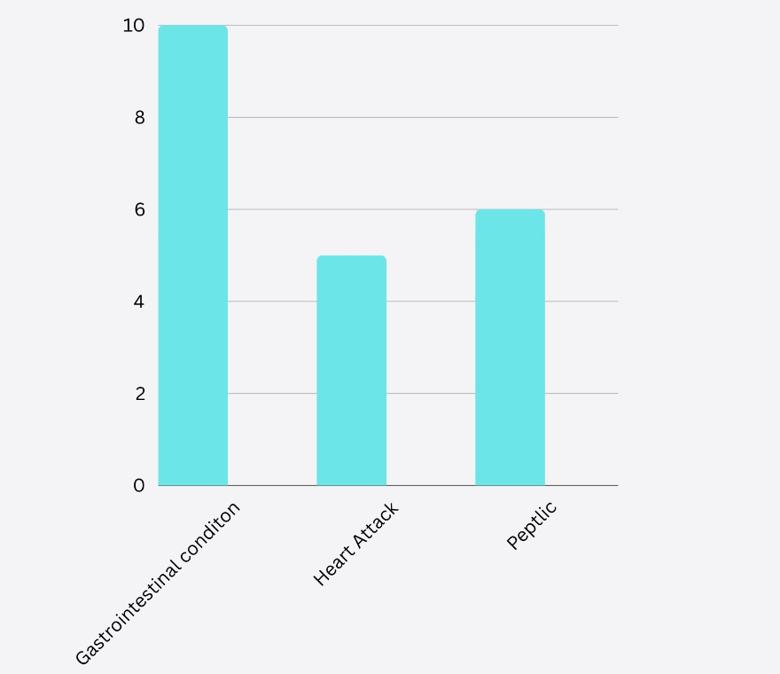
Used Case
For instance, a person experiencing symptoms such as stomach pain, chest pain, and vomiting may potentially be affected by gastrointestinal conditions (80%), peptic ulcers (60%), or a heart attack (50%). The accompanying probability graph visually represents these likelihoods. It aslo provides the first aid i.e. the first step you should take if you are suffreing from these diseases.
First- aid for gastrointestinal conditions –
Hydration, Dietary Adjustments, Rest
Medicine Recommendations:
Antacids:,H2 Blockers (e.g., ranitidine)
First- aid for peptic ulcers –
Hydration, Antacids,Avoid irritants Medicine Recommendations:
Antacids,Cytoprotective Agents,H2 Blockers (e.g., ranitidine)
First-aid for heart attack-
Stay Calm, Help the Person Rest,Aspirin
Medicine Recommendations:
Medications,Oxygen Therapy,Cardiac Rehabilitation

Slide 5
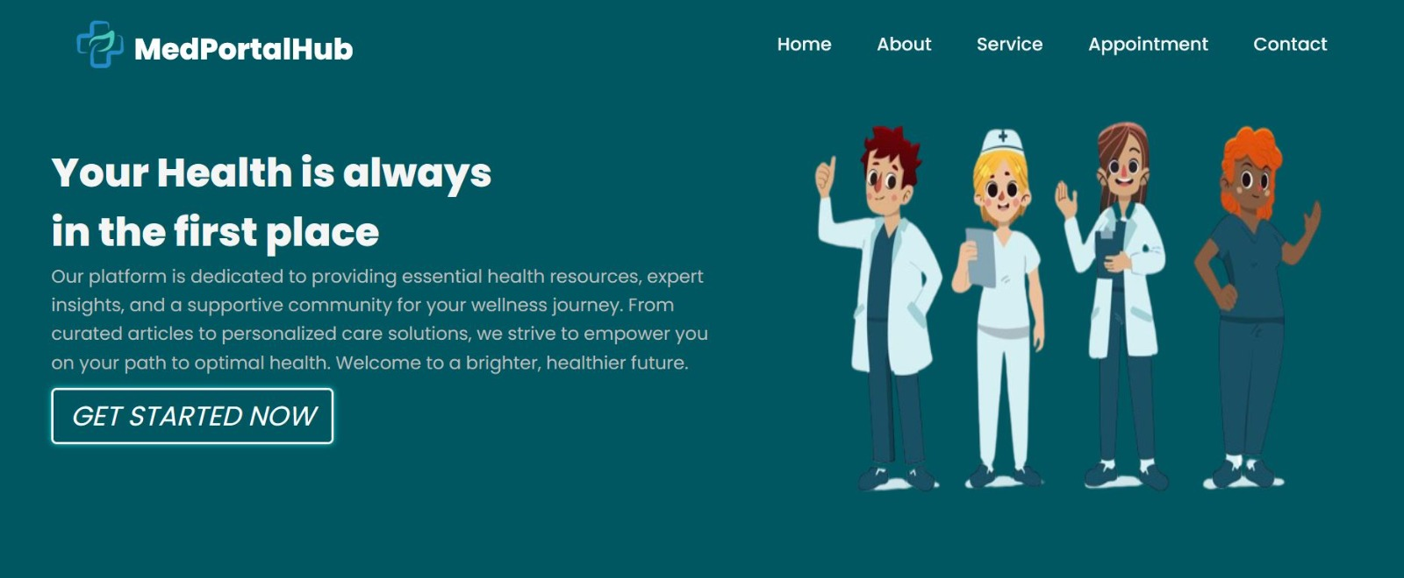
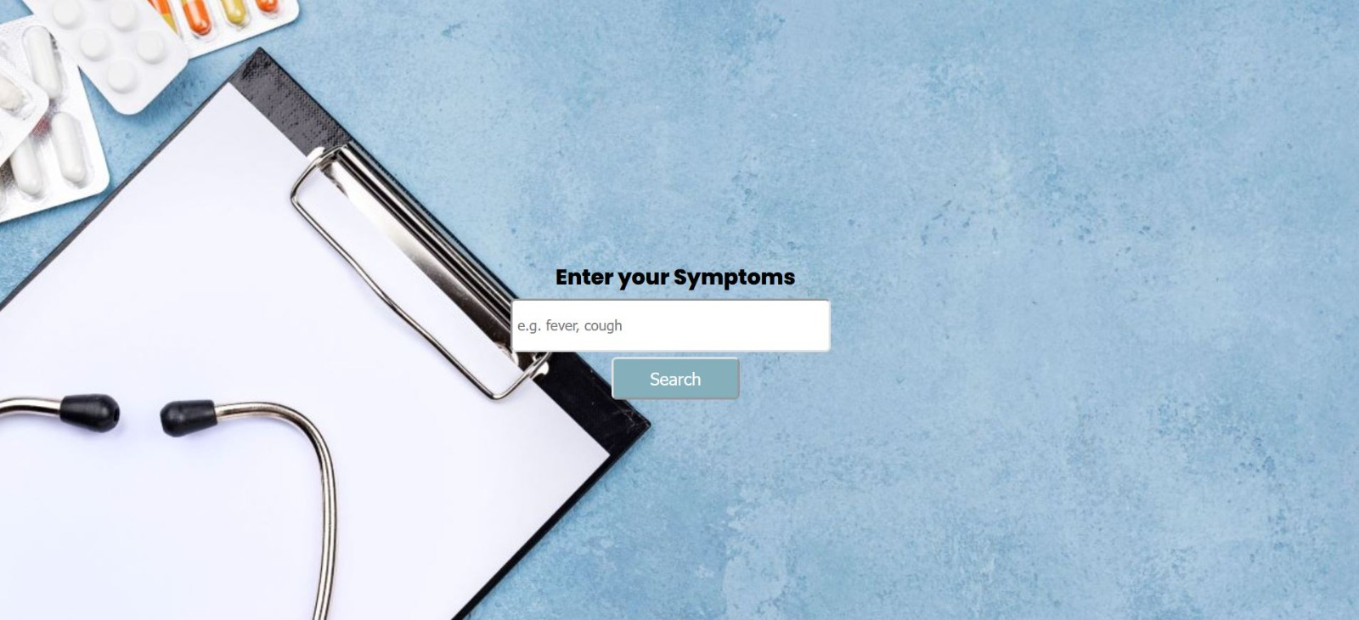
Site Interface

Slide 6




Future Developments and Applications
Enhanced Integration
Expanding capabilities to integrate with diverse medical systems and databases.
Skin disease Detection
We can add camera using AI for uploading images of skin problems .
Advanced Predictive Models
Developing predictive models for personalized and precise treatment recommendations.

Slide 7
Challenges and Limitations
1
2
Integration Complexity
Data Standardization
Challenges related to integrating vast and diverse medical knowledge sources an to the chatgpt free model was difficult as the token were expired.
Ensuring standardization and accuracy in diverse data sources and formats.

Slide 8



Conclusion and Call to Action
Collaborate
Contribute
Explore
Join us in advancing integrative medical research through collaboration.
Contribute your expertise to shape the future of traditional medicine integration.
Explore the potential of ancient knowledge in shaping modern healthcare solutions.

